Slide 1
WAR GAME – EXAMPLE

Slide 2
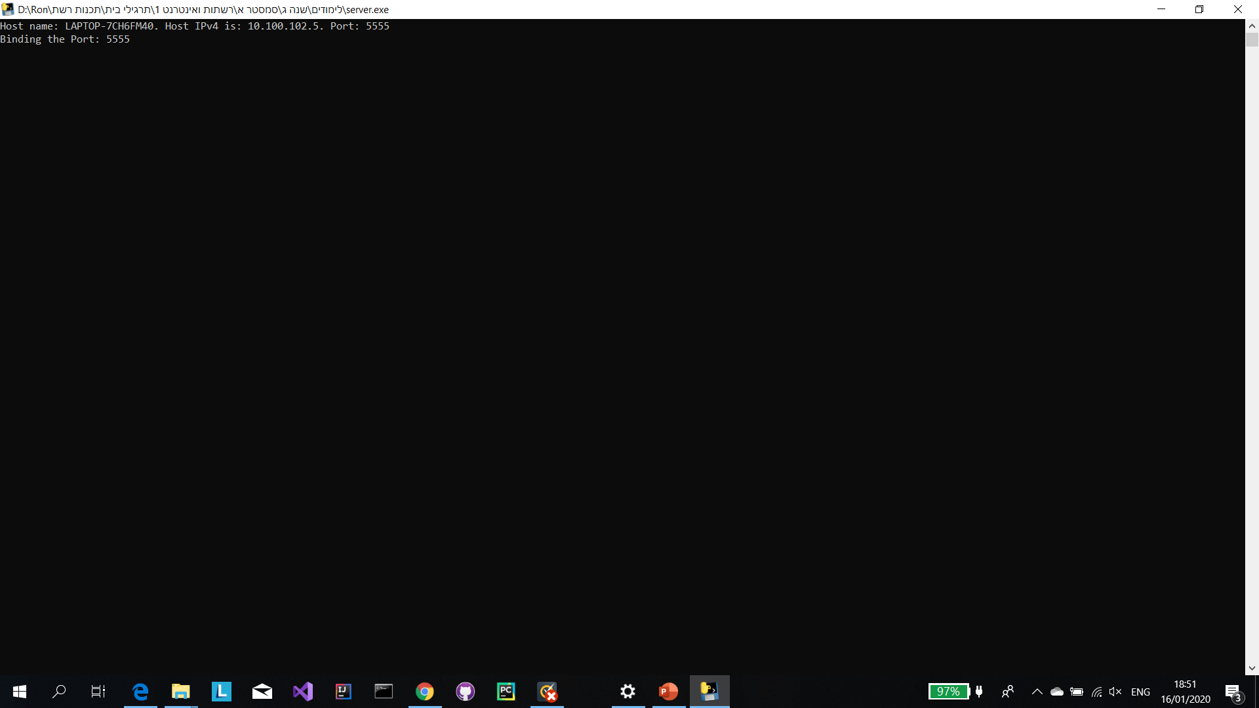
Starting server: server console

Slide 3
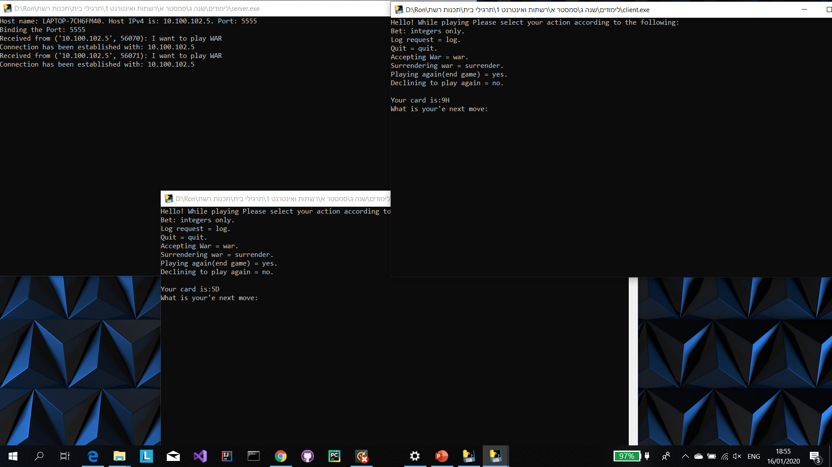
Server console: printing connections' made with msg given by the client
Client 1 console: printing accept message from server and the first card. Waiting for client input
Client 2 console: printing accept message from server and the first card. Waiting for client input

Slide 4
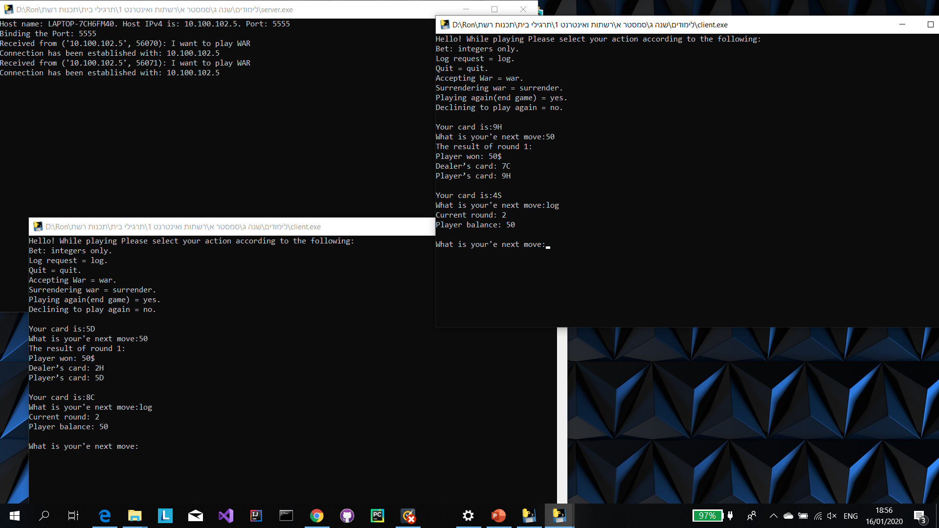
Client 1 console: making a bet + requesting for log
Client 2 console: making a bet + requesting for log

Slide 5
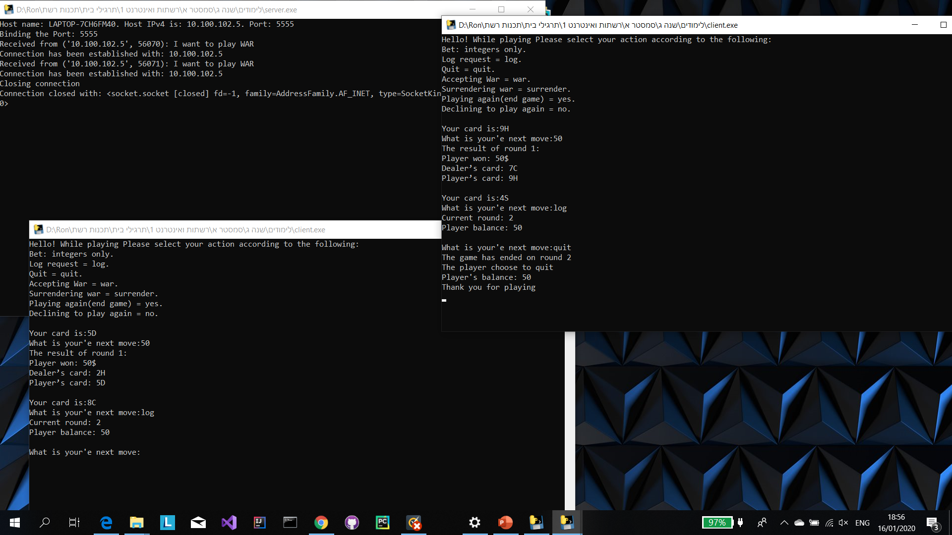
Server console: printing that a client connection has been closed
Client 1 console: mid game quit request

Slide 6
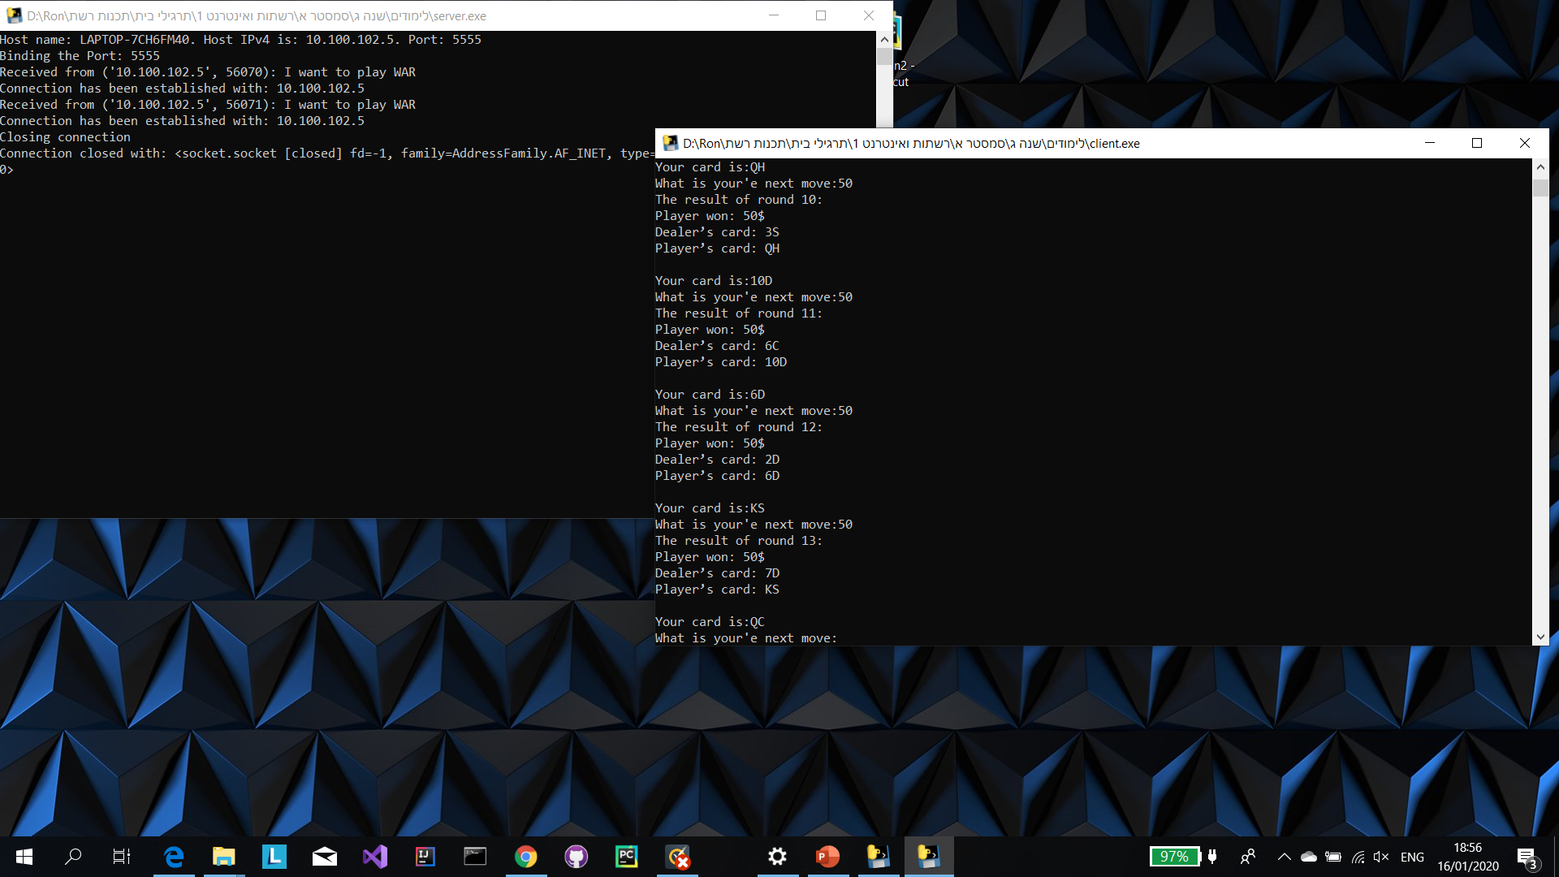
Client 1 console: game continuing

Slide 7
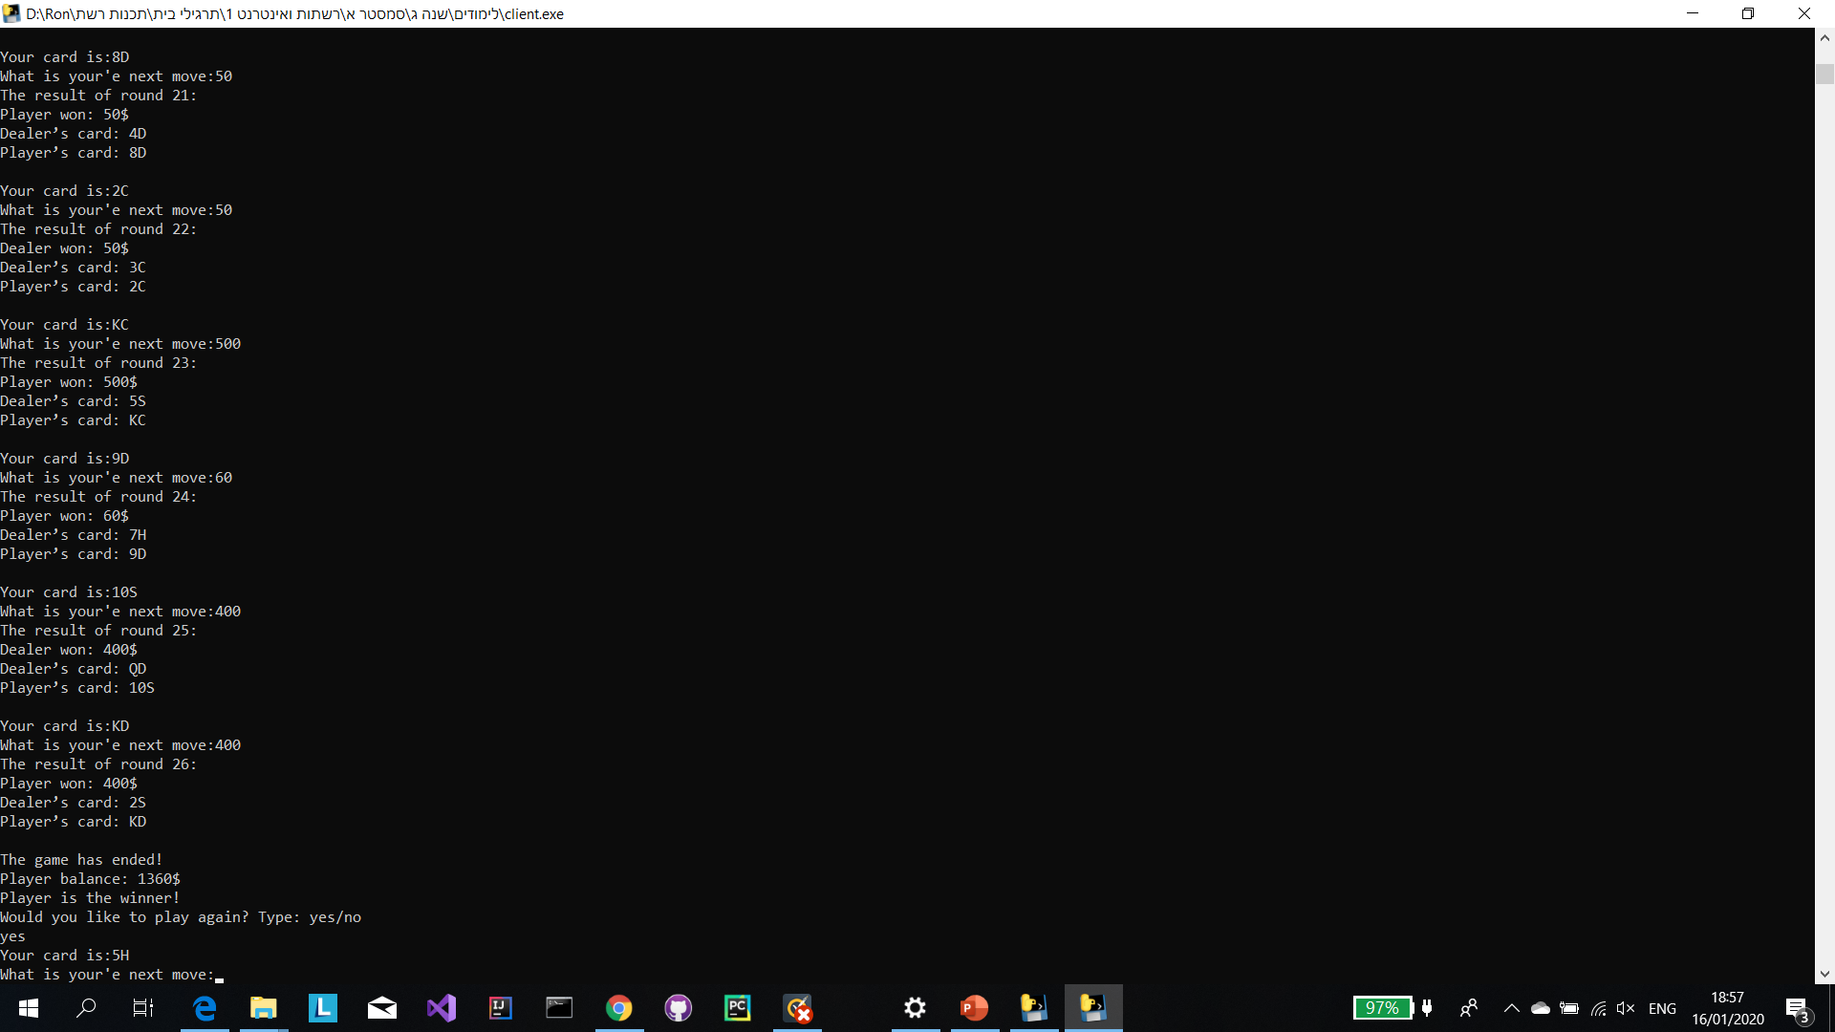
Client 1 console: game end message + requesting to play again. Printed the first card

Slide 8
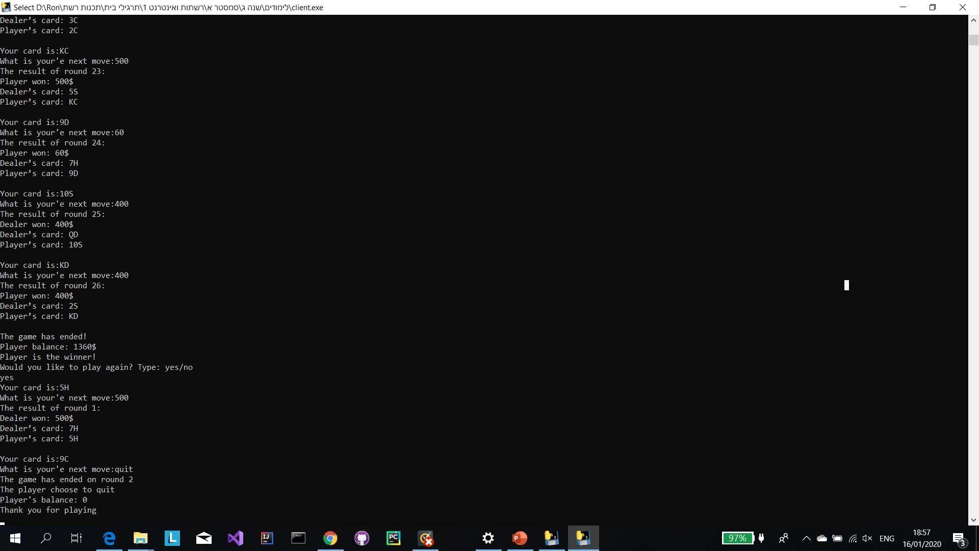
Client 1 console: starting the next game and quit in round 2

Slide 9
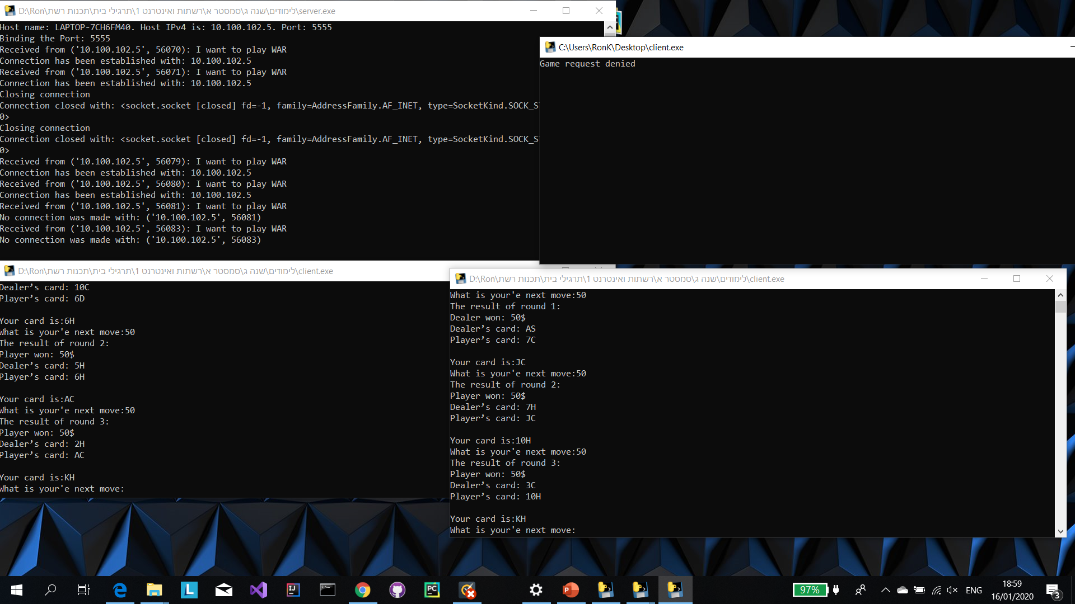
Client 3 console: Game denied message – console will close in 5 seconds
Client 1 console: connected
Client 2 console: mid game quit request

Slide 10
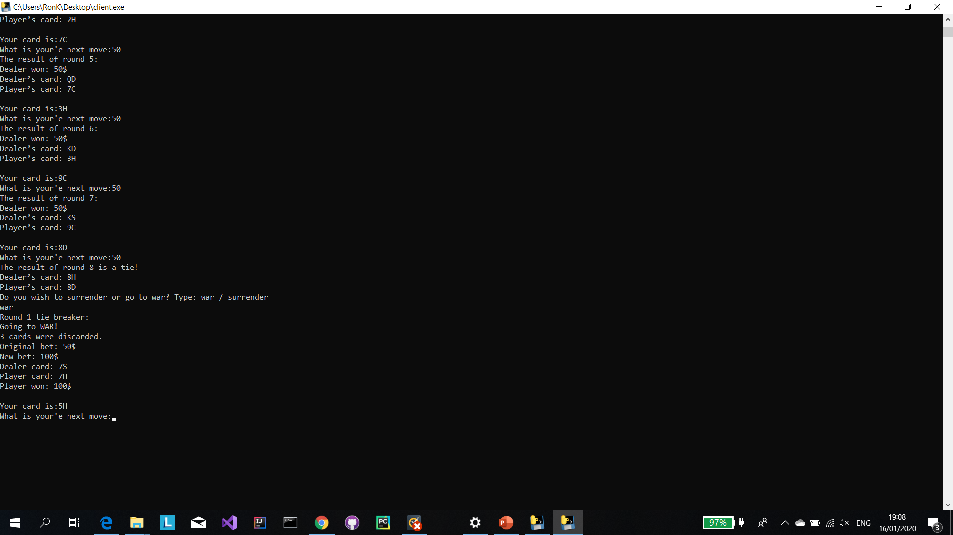
War message example – player choose to war

Slide 11
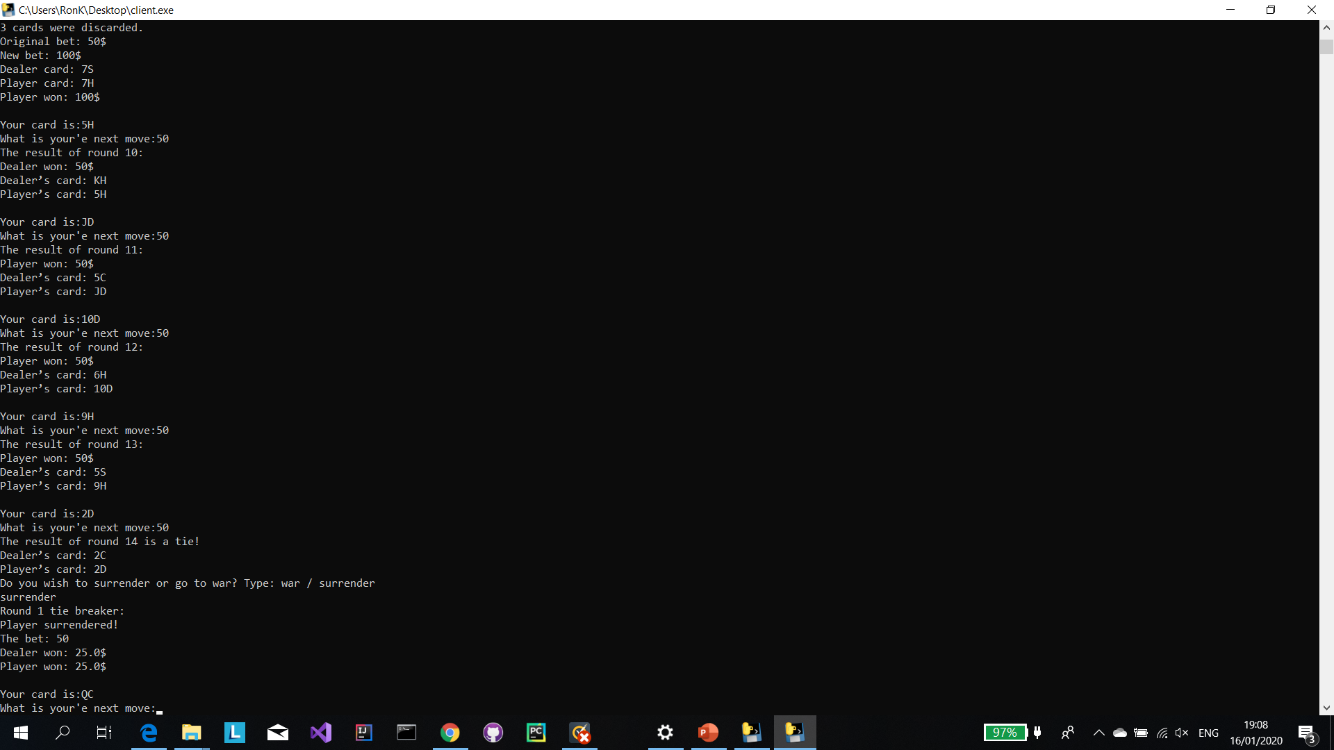
War message example – player choose to surrender

